Slide 1
ICFlash Web-based Network Measurement
Using Adobe AIR
CSE 534 Fundamentals of Computer Networks Professor: Phillipa Gill
Project Team No. 5: Yang Sheng Fang (yafang@cs.stonybrook.edu) Jian Xu (jianxu1@cs.stonybrook.edu) Benjamin X. Lin (xianlin@cs.stonybrook.edu)

Slide 2
Overview & Motivation
Overview: ICFlash allows users to send HTTP/DNS requests to specified websites and upload corresponding results to Centinel-Server
Motivation: To encourage more users to participate in the data-collection process
Provide GUI
Installation is much more convenient for users
Users do not need any extra configurations
ICFlash · May 07, 2015 · Y. Fang, J. Xu, B. Lin
Notes:
Improvement!

Slide 3
Methodology & Procedure
Reviewed Technologies:
HTML5
JavaScript
PHP
Adobe Flash
Adobe AIR
ICFlash · May 07, 2015 · Y. Fang, J. Xu, B. Lin

Slide 4
Methodology & Procedure
Reviewed Technologies:
HTML5
JavaScript
PHP
Adobe Flash
Adobe AIR
Adobe AIR provides APIs for DNS queries and HTTP requests.
It does not have cross domain restrictions.
ICFlash · May 07, 2015 · Y. Fang, J. Xu, B. Lin

Slide 5
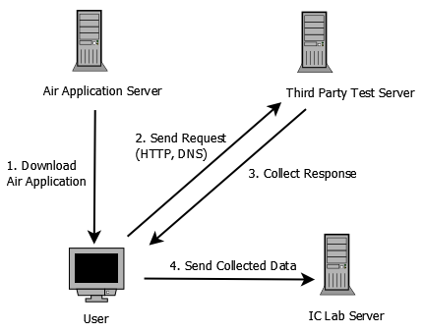
Methodology & Procedure
ICFlash · May 07, 2015 · Y. Fang, J. Xu, B. Lin

Slide 6
Methodology
(1) Open source Flex Framework for UI
(2) flash.net for HTTP and flash.net.dns for DNS
- collect response Header and body for Http; collect response for DNS - asynchronous call
(3) JSON for storing results
(4) Github for source control, can be accessed publicly
ICFlash · May 07, 2015 · Y. Fang, J. Xu, B. Lin

Slide 7
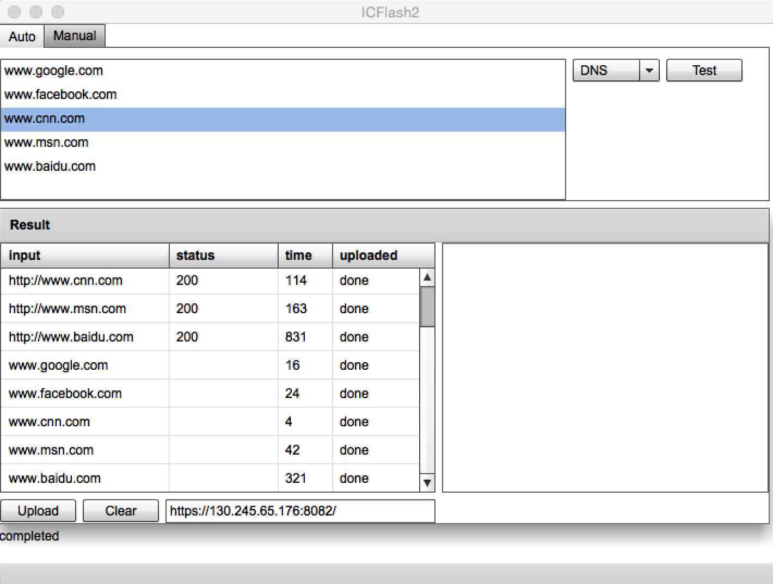
Results
ICFlash · May 07, 2015 · Y. Fang, J. Xu, B. Lin

Slide 8
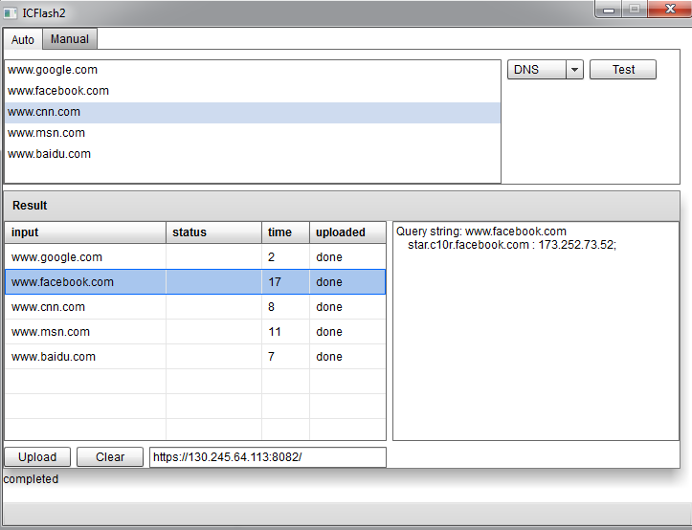
Results
DNS Query Results on ICFlash App
RESULT
ICFlash · May 07, 2015 · Y. Fang, J. Xu, B. Lin

Slide 9
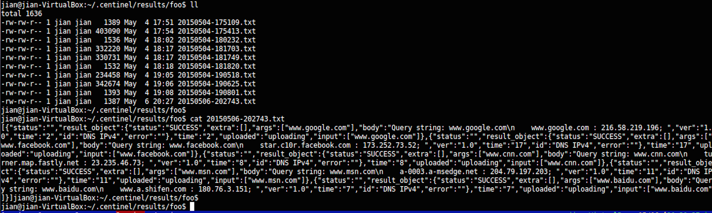
Results
DNS Query Result to Local Server
RESULT
ICFlash · May 07, 2015 · Y. Fang, J. Xu, B. Lin

Slide 10
Conclusion + Future Work
(1) Connect ICFlash to the real ICLab Centinel Server
(2) Allow users to write their own list of URLs to test and upload
(3) Promote ICFlash to those volunteers who participate in the ICLab experiments.
ICFlash · May 07, 2015 · Y. Fang, J. Xu, B. Lin

Slide 11
THANK YOU!
Special Thanks To
Professor Phillipa Gill
Abbas Razaghpanah
Chien-Chun Ni
ICFlash · May 07, 2015 · Y. Fang, J. Xu, B. Lin

